Slide 1
Quality and Expanded Access to University: Can they be reconciled?
International Seminar MUFRAMEX-PIPE/CIDE
Transition between High-School and University:
Comparative studies between Mexico and France
Toulouse, France
November 7, 2018
Blanca Heredia
PIPE-CIDE

Slide 2
Data glimpses…
58% of 15-year-old Mexican students aspire to finish a bachelor’s degree (Germany: 18%, South Korea: 75%).
However, only 17% of adults in Mexico (25 to 64 years old) have higher education. This number is 20 points below the OECD average: 37%. (OECD, 2018).
In Mexico, adults with a higher education degree earn, on average, more than double than the adults with only upper secondary education. (OECD, 2018).
Source: Graph made with data extracted from the Mexican Ministry of Education public databases.

Slide 3
Total offer of HE is rising
4 479
4 198
2 468
2 580
Source: EPM, 3er Informe de Gobierno

Slide 4
Higher Education in Mexico: Outlook and Dilemmas
Very significant potential for growth, but...
Main obstacles
  Supply: limited spaces qnd insufficient funding
  Demand: only 25% of those that begin Elementary education finish High School
  Equity: student top decile 17 times more likely to access HE than bottom decile and if h/se does – lower quality institution
Private and Social Returns of Higher Education:
  Important, but decreasing, salary premium
  Very limited growth of the supply for qualified jobs
  Problems in quality and pertinence (mismatch HE – Labor market)

Slide 5
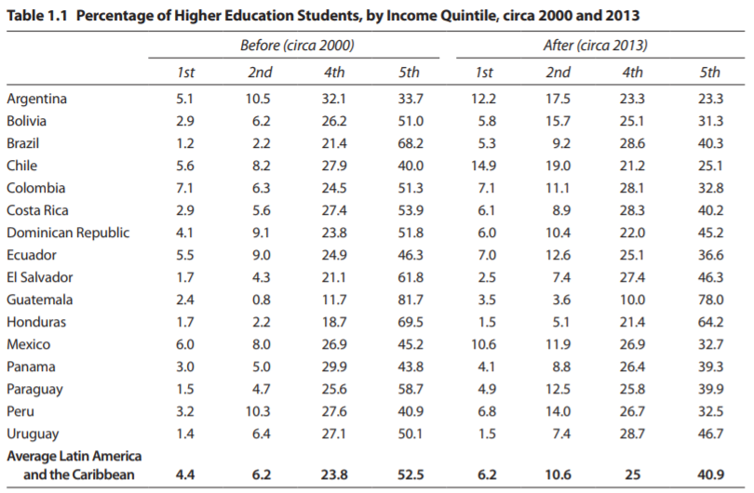
Although it is much easier for higher income students to access HE, the percentage of young people with lower incomes getting into university increased between 2000 and 2013.
Source: Ferreyra et al, At a Crossroads Higher Education in Latin America and the Caribbean, 2017.

Slide 6
Challenges of Higher Education in Mexico
Access barriers: incomplete educational trajectories and strong access asymmetries
Major mismatches between HE programs and labor market demands
Financing

Slide 7
Incomplete educational trajectories
Average progress for school-age population*
Start Primary Education:
98%
Finish High School: 25%
Complete undergraduate degree: 13%
*From the age reference of 15 years and grade level for 2007/2008
Source: Mexicanos Primero, 2009, Against the wall. State of education in Mexico 2009..

Slide 8
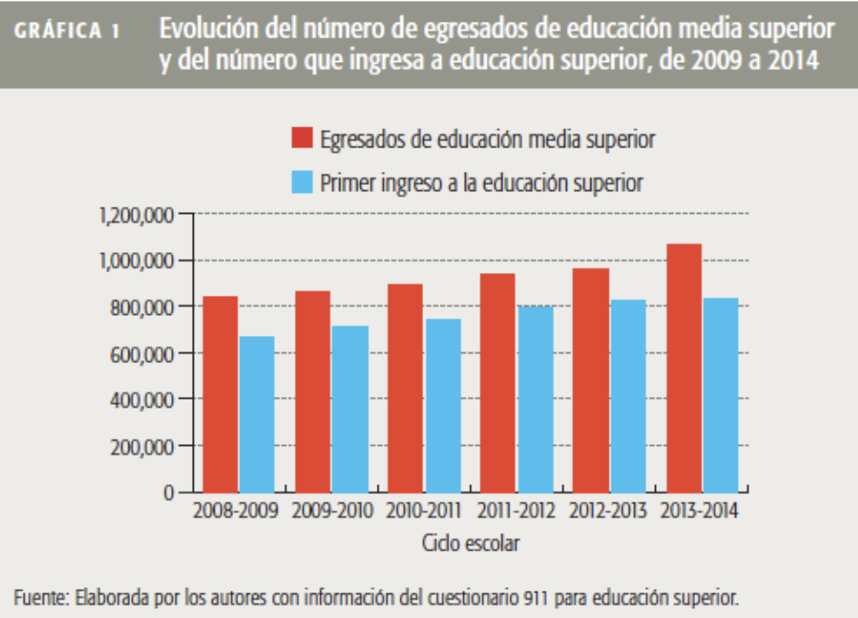
Supply and demand of Higher Education (1)
Source: Salvador Malo y Alfonso Hernández, 2014 Educación Superior: Apuesta de futuro, 1sept.

Slide 9
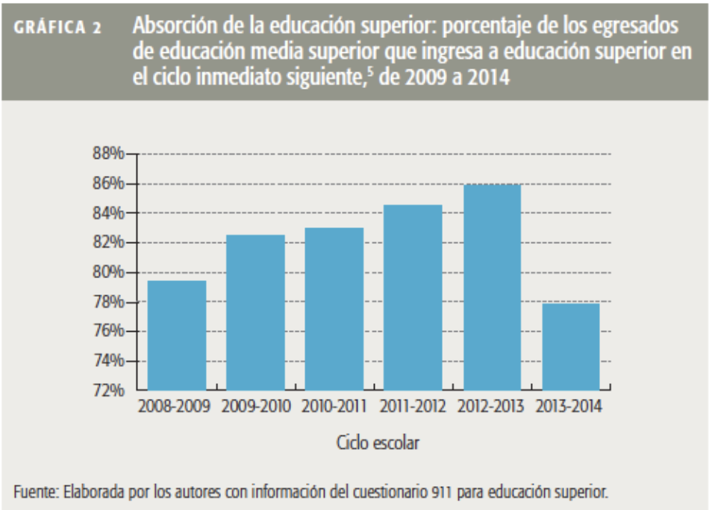
Supply and demand of Higher Education (2)
Source: Salvador Malo y Alfonso Hernández, 2014, Educación Superior: Apuesta de futuro, 1sept.

Slide 10


Data 2016-2017. Higher Education in Mexico (private)
3,103 schools
(58% of the total)
1,106,968 youngsters
18 to 25 years of age
(3 out of 10 youngsters)
156,652 teachers
(4 out of 10 teachers)
601,084 women
(31% of the total)
505,884 men
(27% of the total)
Source: Main results of the national education system 2016-2017, Ministry of Education.

Slide 11
Employers with problems filling vacancies (Mexico)
Question to employers:
Do you have or have had a vacant positions without them being occupied despite having candidates?
Reasons why vacancies are not covered by employers
Fuente: CIDAC (2014) Encuesta de Competencias Profesionales (ENCOP).

Slide 12
…but, Higher Education graduates have major difficulties finding qualified jobs
Between 2005 and 2010, in Mexico:
  3.5 million graduates of higher education
  500 thousand jobs that required that level of qualification
Source: B.Heredia and L.Ortíz, Active Labor Market Policies (ALMPs) in Mexico: 2000-2011: Assessment and Recommendation. World Bank, 2012.

Slide 13
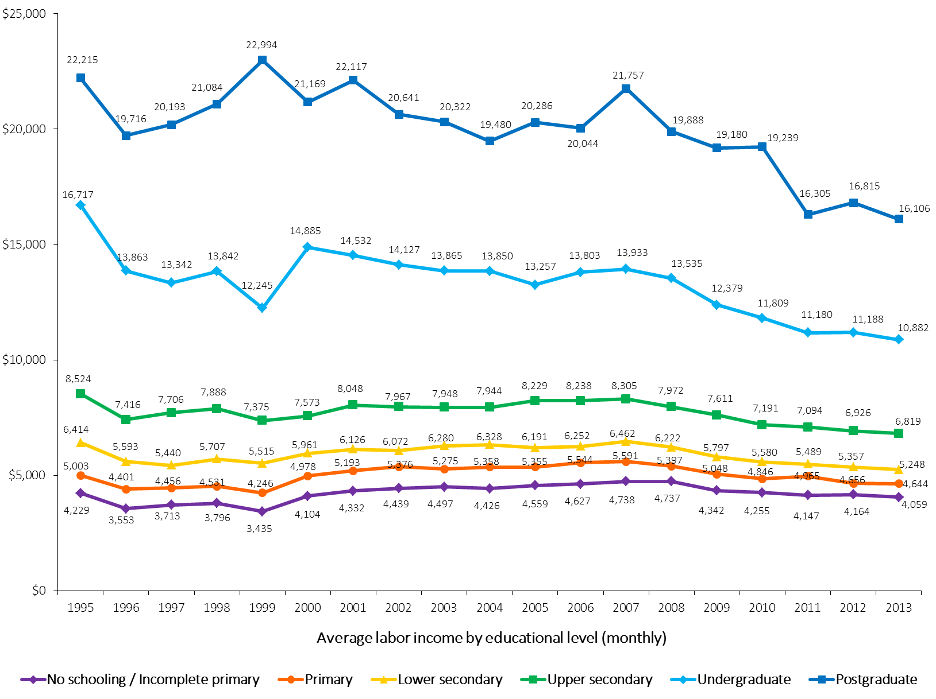
Decreasing income in graduated students of Higher Education
1995-2013 Ingreso laboral promedio, por nivel educativo
(PESOS de 2013)
16, 717
10, 882
Source: Centro de Estudios Espinosa Yglesias (CEEY) estimates based on the ENE 1995-2004 ENE and the ENOE 2005-2013

Slide 14
AMLO
1
Massive scholarship program for High School students to promote school permanence
2
Possible elimination of admission exams for entry into HEI
3
Creation of 100 new universities
4
300,000 high scholarships for HE (2,500 mexican pesos per month)
Source: Nation Project 2018-2014. Available at: https://drive.google.com/file/d/1UwBfA6aW1vyqyPzI2NxZ177yc81Kk6wc/view

Slide 15
Questions and dilemmas on the table
Social costs and benefits of increasing access to Higher Education
Financing access expansion
Education and employment gap
Is it possible to reconcile quality and expanded access?

Slide 16
HE access expansion in a very inequal society

Slide 17
Proposals
Single High School exit examination would help promote equity and transparency in education.
Leveling courses to increase equity in access to HEI without having to sacrifice quality.
Linkage of public financing with quality and HEI results.

Slide 18
END
Merci

